Slide 1
WELCOME TO BOXING

Slide 2
Anhui Boxing Machinery CO.,LTD
1
Company profile
目录
Company introduction, corporate culture, organizational structure, qualification certificate, corporate honor, production capacity, customers, etc.
2
System operation
The control process from incoming to outgoing inspection
CONTENTS
3
Supply chain management
Customer requirements and supplier management
4
Strategic planning, investment direction
Introduce the investment direction and focus of the company in the next stage
5
The company environment
The photos of working environment and organization team，etc.

Slide 3
Anhui Boxing Machinery CO.,LTD
01 CHAPTER ONE
Company profile

Slide 4
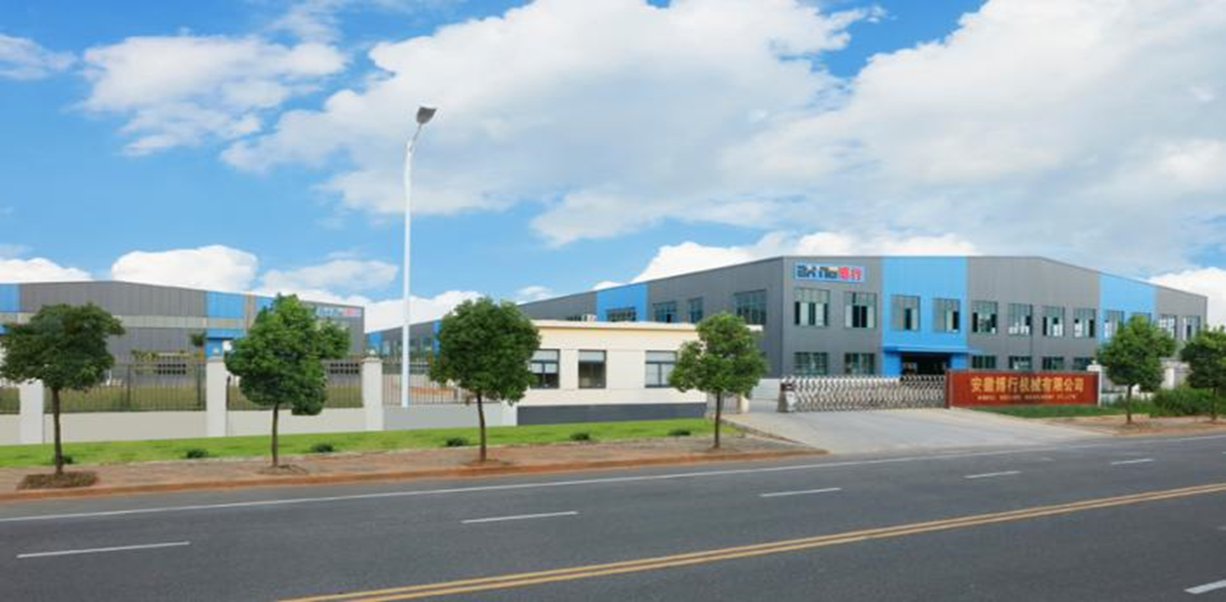
Part 1
Introduction
Anhui Boxing Machinery Co., Ltd
Building Excellence with Care and Devotion, Nurturing Corporate Development with Innovation!
Anhui Boxing Machinery Co., Ltd., formerly known as Yuhuan Boxing Machinery Co., Ltd., was founded in February 2008, and we built a 25000㎡ modern factory in Guangde Economic Development Zone in 2015, is a comprehensive automotive brake technology company which designs, manufactures and sells braking system components. We are specialized in developing and manufacturing auto brake calipers，brake caliper parts and hardware kits as well as drum brake parts and hardware kits.

Slide 5
Part 1
Introduction
Anhui Boxing Machinery Co., Ltd
Boxing Machinery Co., Ltd. has been in steady and rapid development for ten years. Centering on the development demands of the company's industrial chain, Boxing Machinery Co., Ltd. has been developing to the group corperation. Gradually set up several supporting branch company.
2019/03 Anhui Fengxing Brake Technology Co., LTD Main Business scope: Brake caliper piston, guide pin, mold processing manufacturing；
2019/05 Chenxiang Auto trading co., Ltd. Main Business scope: Brake pad of brand "Xing”,“MARHOP”lubricant.
2019/07 Xuanhui Surface treatment Co., ltd Main Business scope: phosphating , tin plating, zinc nickel alloy and other surface treatment
2019/05 Chenxiang Auto Supply Store Main Business scope: Car repair, maintenance, beauty, sheet metal, sales, B2B mall
2020/12 Anhui Guoxing Auto Parts Co., LTD Main Business scope: Gardening tools 、auto parts etc.

Slide 6
Part 1
Corporate culture
Corporate Vision：
--Boxing is committed to build the world‘s No. 1brand of in brake hardware kit field.
Corporate mission：
--We are committed to making every car in the world be equipped with the brake components of Boxing.
Staff mission：
--Loyal, pragmatic, rigorous, effective, and to be faithful to our original aspiration!
Management idea：
--innovation first, quality first, win-win cooperation！
Corporate culture:
--Gather an upward strength to create a win-win team
Core Value：
Customer first, honest and trustworthy；
Loyalty and dedicated, teamwork；
Times and thanksgiving society；

Slide 7
Part 1
Organization Chart
董事长
总经理
人事行政部
销售部
品质部
生产部
PMC
采购部
质量体系部
物流部
技术部
财务部
级进模车间
冷挤压车间
机加车间
压淬车间
模具车间
热处理车间
卡钳装配压车间
包装车间
原材料仓库
五金仓库
导销成品仓库
外协仓库
中转仓库
成品发货仓库

Slide 8
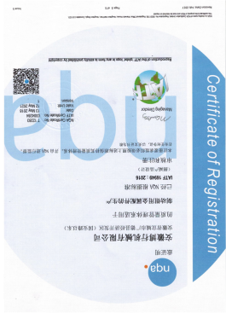
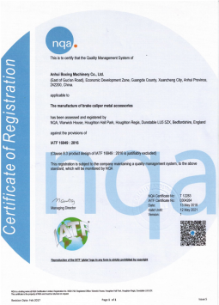
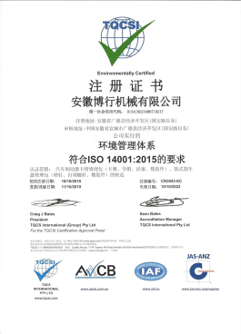
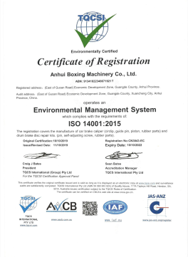
Part 1
Qualification certificate
IATF 16949质量管理体系认证(中文版）
IATF 16949质量管理体系认证(英文版）
ISO14001环境管理体系认证（中文版）
ISO14001环境管理体系认证（英文版）

Slide 9
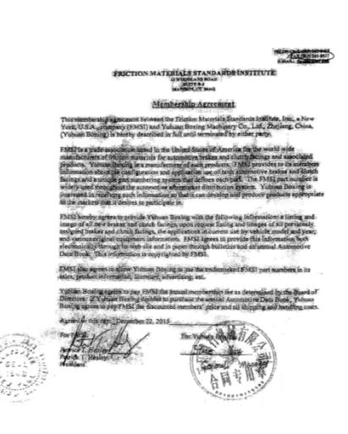
Part 1
Industry member
Membership
1、We became a member of FMSI on Nov 22,2015.The left is the copy of contract with FMSI
2、In order to be more efficient of developing business and get the newest industry information, we also become a member of TecDoc.
FMSI 2015年11月22日入会合同复印件

Slide 10
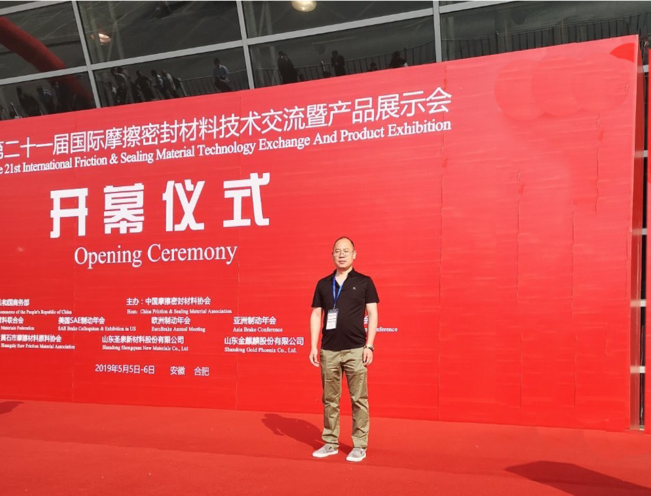
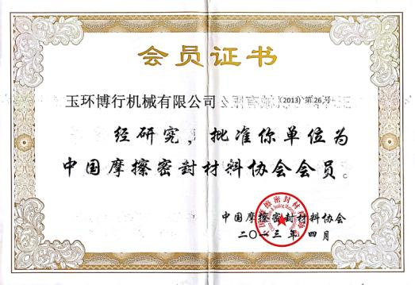
Part 1
Industry member

Slide 11
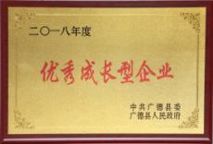
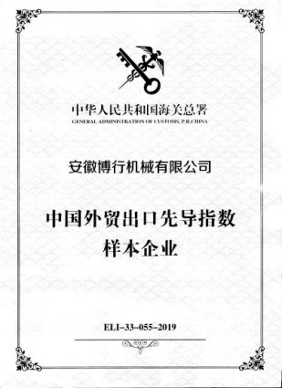
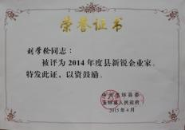
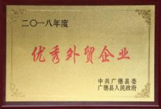
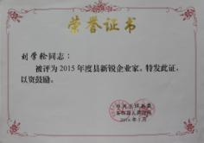
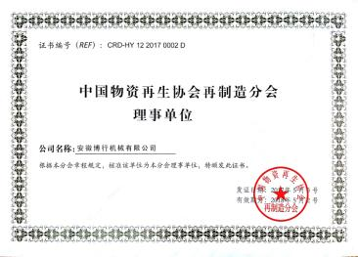
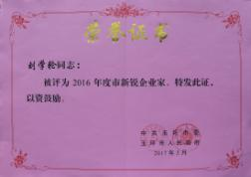
Part 1
Corporate honor

Slide 12
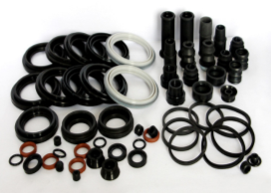
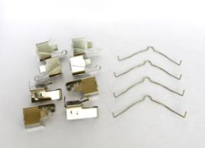
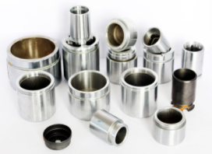
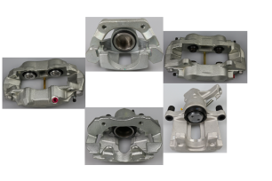
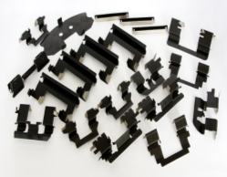
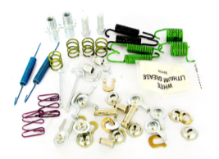
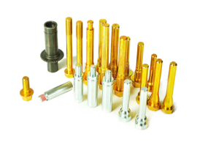
Part 1
Main Product
Rubber parts
Disc Brake Hardware kit
Caliper pistons
Brake Caliper
Pad clips
Drum Brake Hardware kit
Guide pin and Fasteners

Slide 13
Part 1
Production Capacity
Summary of production equipment and capacity
No. | Workshop | Main Equipment | Qty | Main product | Capacity (Ten thousand pcs/Year) | Remark
1 | Automatic Stamping | C type crankshaft high-precision punching machine | 22 | Pad clips | 20000
2 | Machining Center | CNC | 12 | Brake Caliper | 20-30
 |  | Milling Machine | 2
 |  | CNC Lathe | 3
3 | Heat treatment | Salt bath furnace | 1 | Products requiring heat treatment | 20000
4 | Pressure Quenching | Pressing machine | 2 | Blade | 1000
 |  | Pressure quenching furnace | 1 |  | 1000
 |  | Tempering furnace | 1 |  | 1000
5 | Clod Forging | 300T hydropress | 1 | Brake caliper piston | 1500 | In the trial production
 |  | 500T hydropress | 1
 |  | 1000T hydropress | 1
6 | Packing | Automatic packing machine | 2 | Brake repair kits | 5000
 |  | High frequency heat bonding machine | 2 | Components | 10000
7 | Caliper assembly | Manual assembling line | 1 | Brake Caliper | 20-30
 |  | Semiautomatic assembly line | 1

Slide 14
Part 1
生产能力
Summary of production equipment and capacity
No. | Workshop | Main Equipment | Qty | Main product | Capacity (Ten thousand pcs/Year) | Remark
1 | Piston Workshop | CNC Lathe | 35 | Brake caliper piston | 800
 |  | Centerless grinder | 5 | Brake caliper piston | 1500
2 | Guide pin Workshop | CNC Lathe | 18 | Guide pin | 5000
 |  | Bench drill | 5 | Guide pin | 5000
 |  | Thread roller | 2 | Bolt | 8000
3 | Stamping Workshop | Punching machine | 30 | Pad clips | 2000

Slide 15
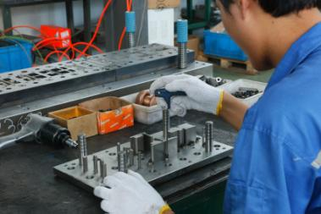
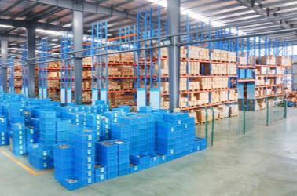
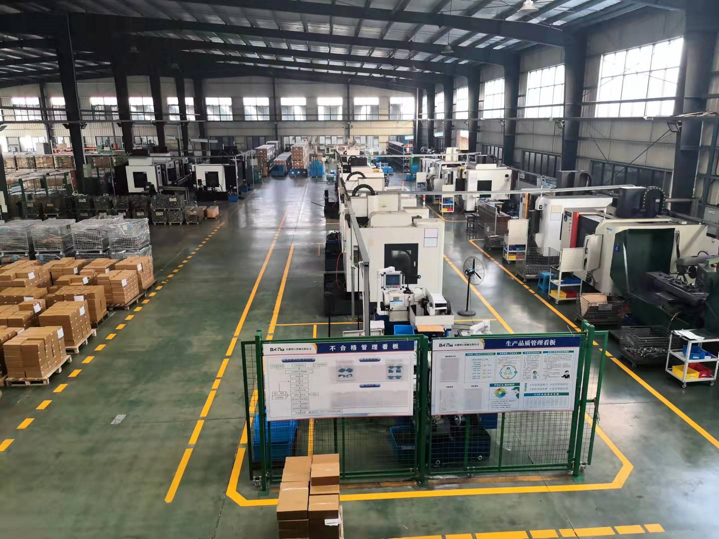
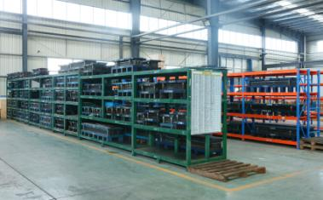
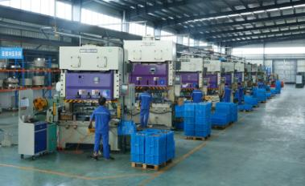
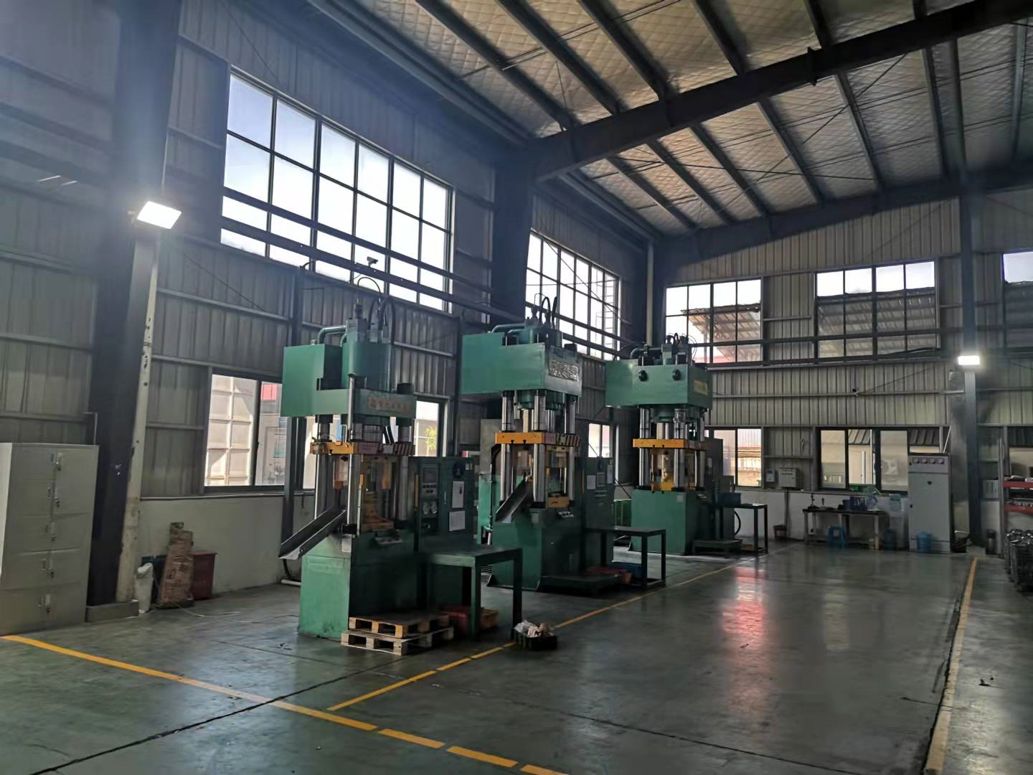
Part 1
Company environment

Slide 16
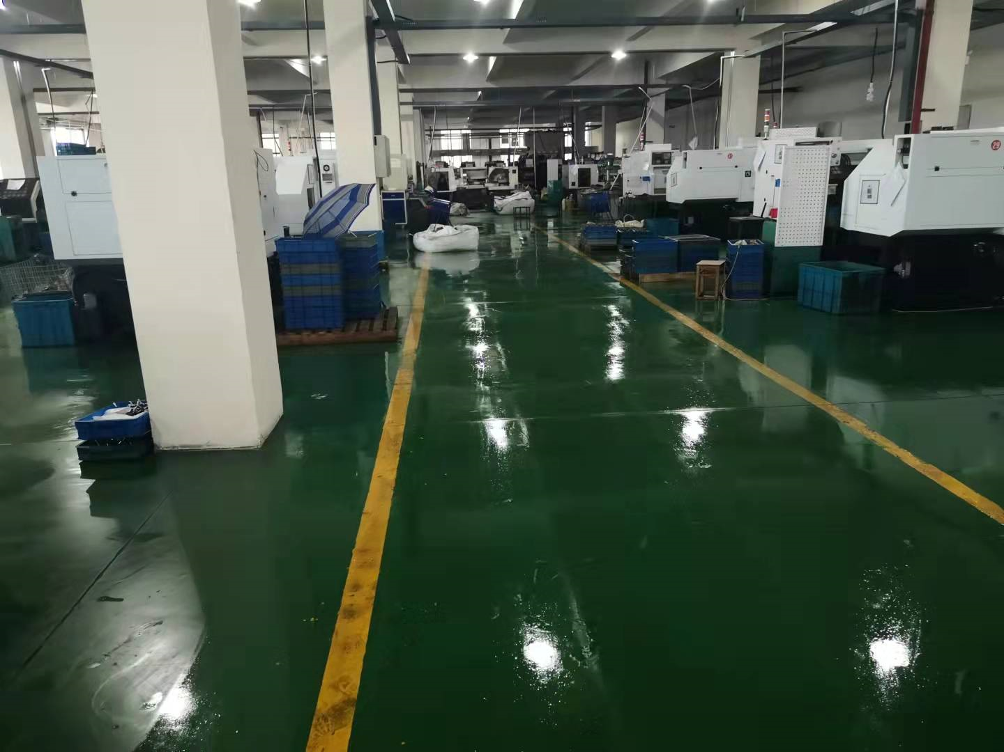
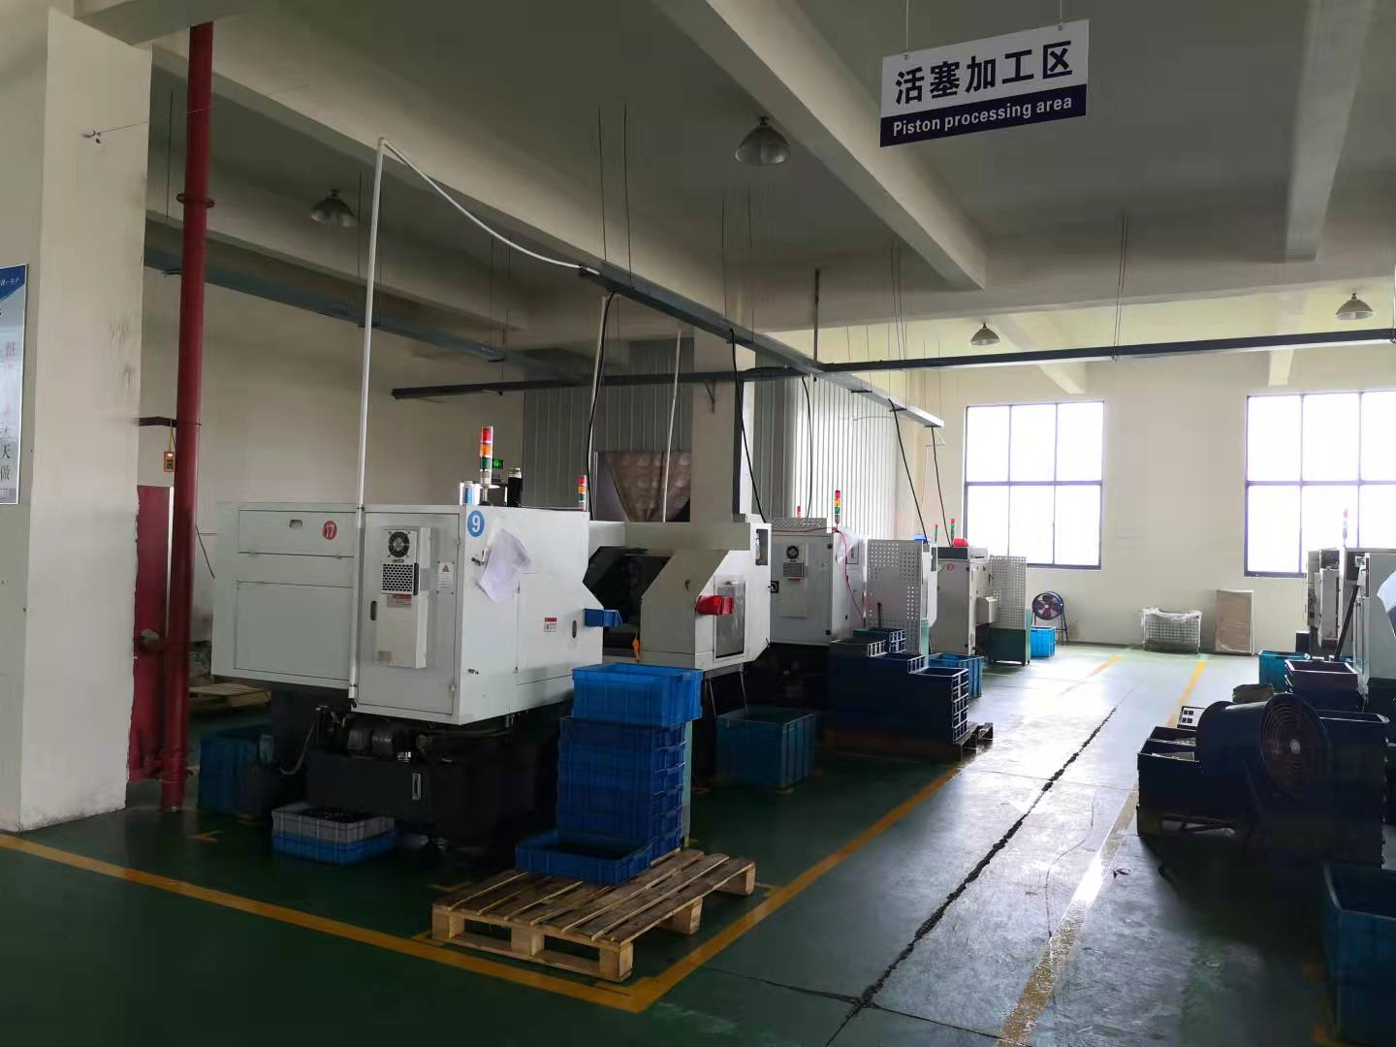
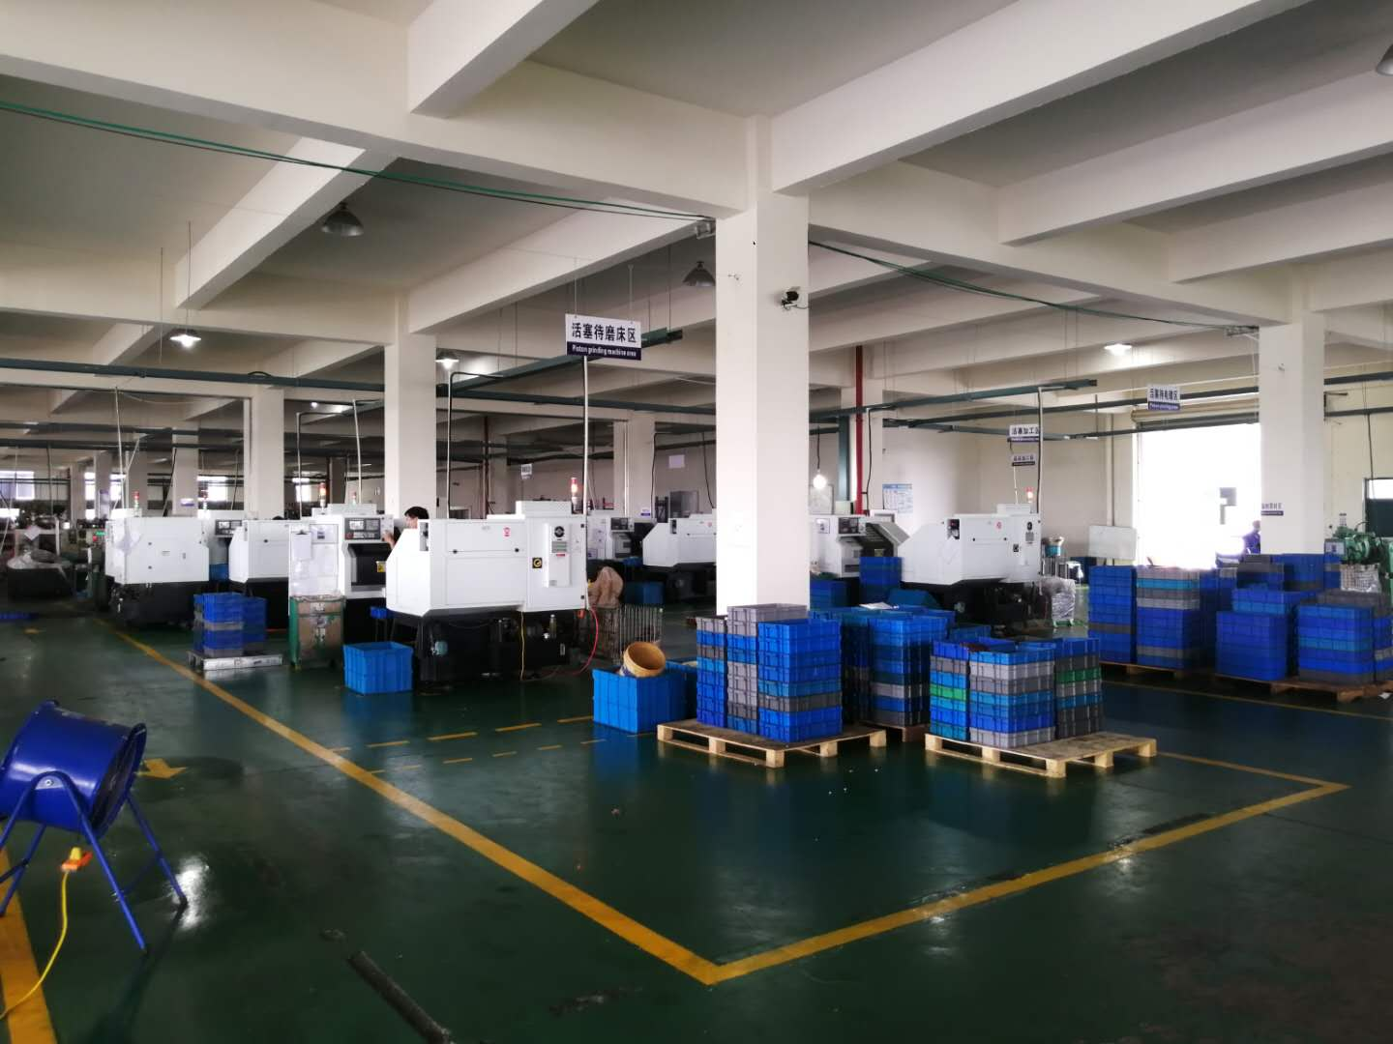
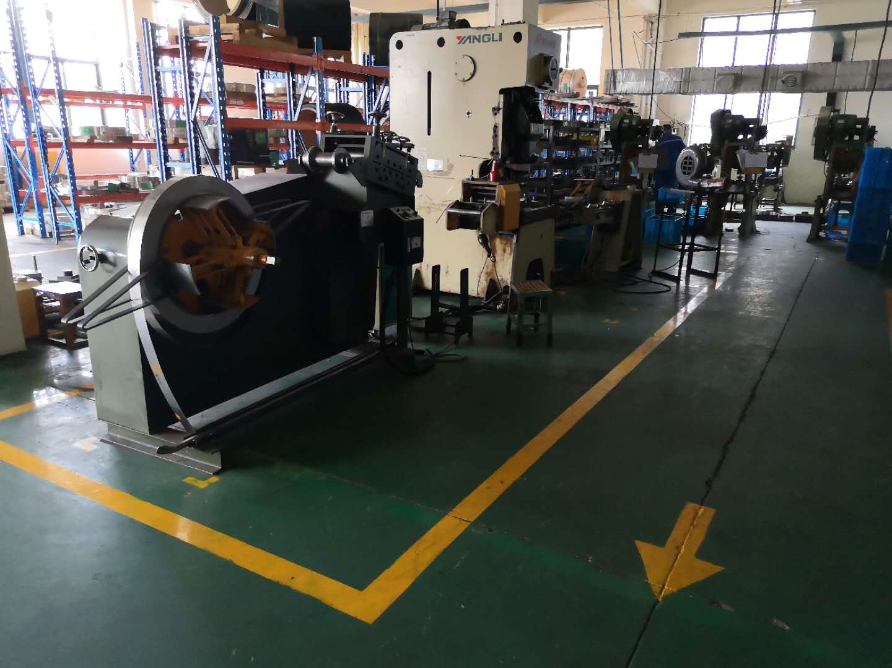
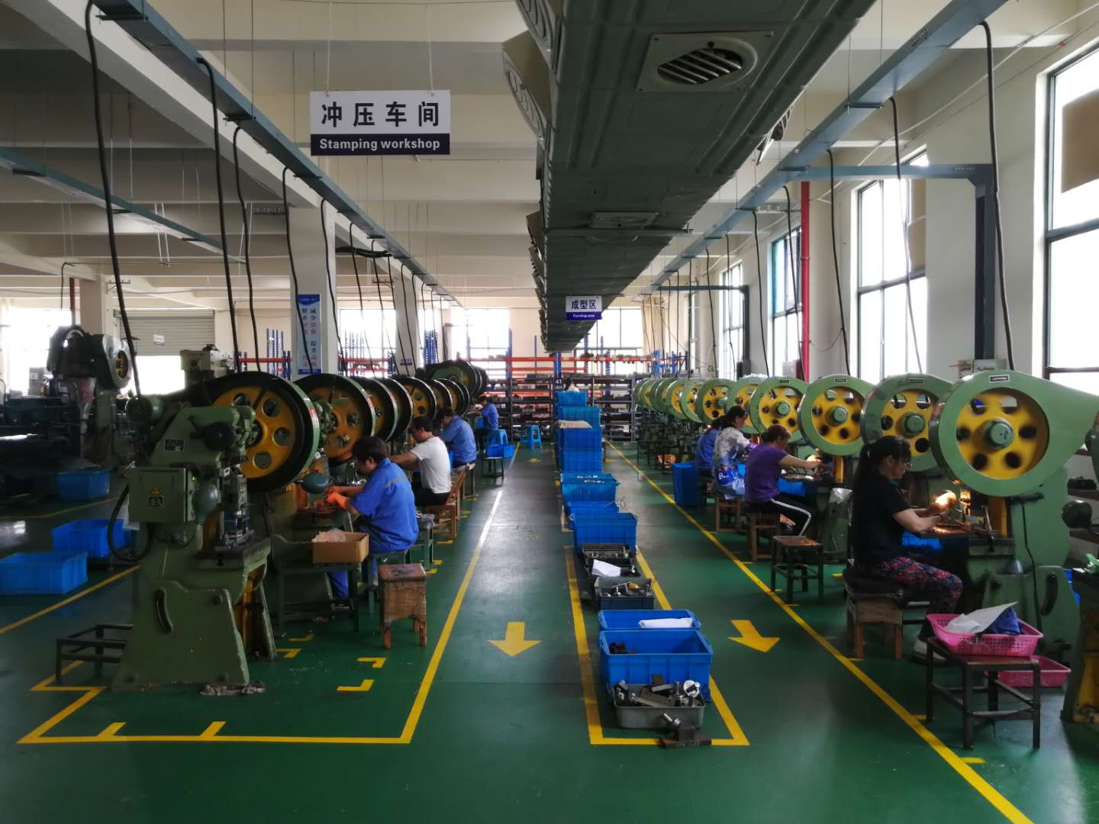
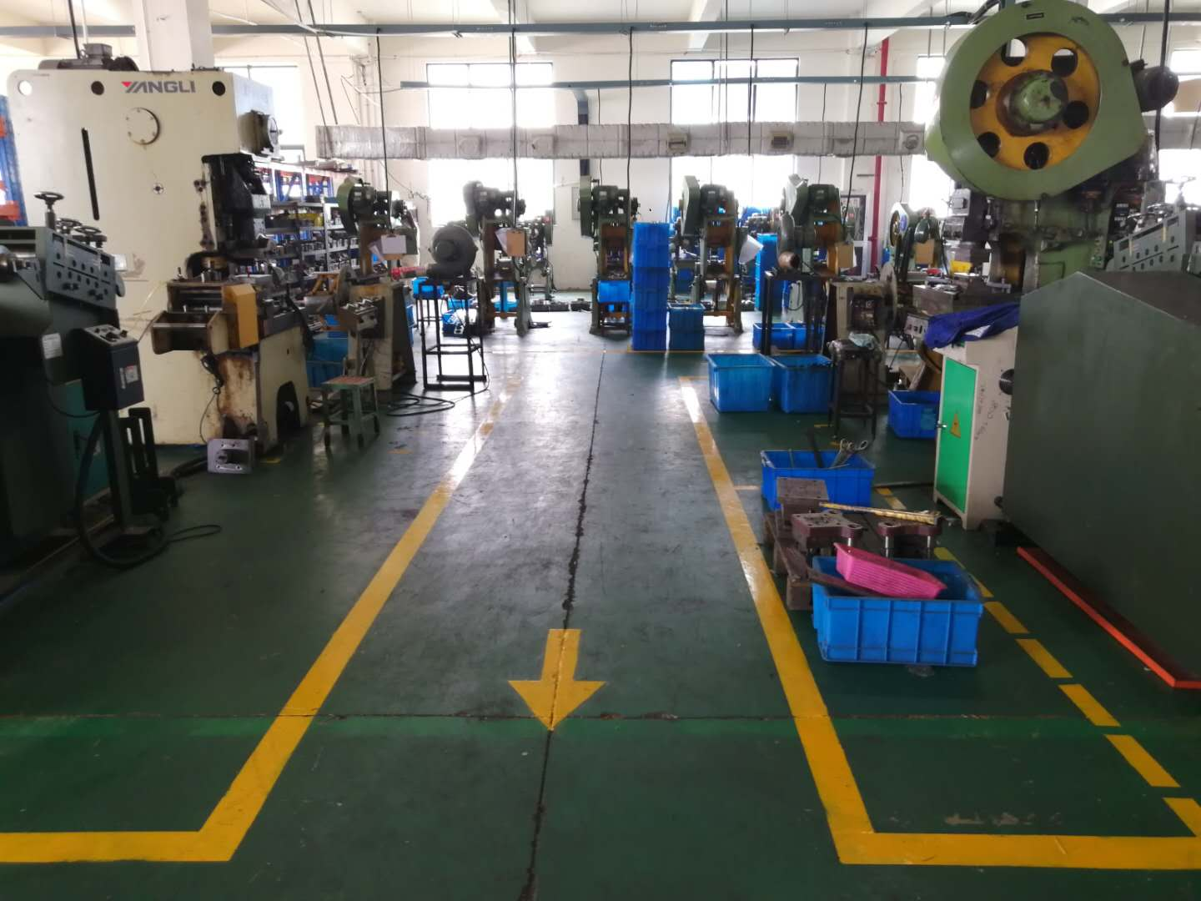
Part 1
Company environment

Slide 17
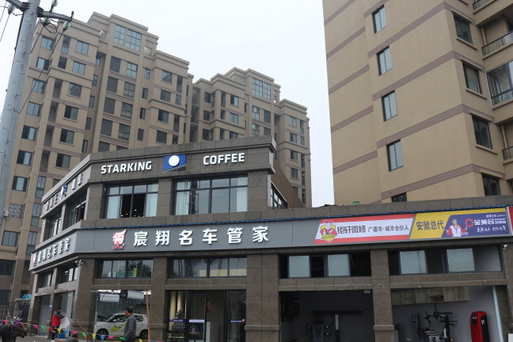
Part 1
Subsidiary-Chenxiang Auto trading co., Ltd.
Part 1
Chenxiang Auto trading co., Ltd. is under the Anhui Boxing Machinery Co., Ltd brand, established at January 1,2021.
Chenxiang has a full range of high-quality professional team to provide car repair, maintenance and beautification.
。
Chenxiang has advanced professional equipment and tools, can provide large-scale, standardized, professional car maintenance and beautification. And Chen Xiang has reached the advanced level of the industry for product technology and quality control.
Unique 3C services (CAR, CLUB, COFFEE) is based on high-end positioning and quality services, can provide a separate operation of the Star King cafe chain, in-depth customized services.

Slide 18
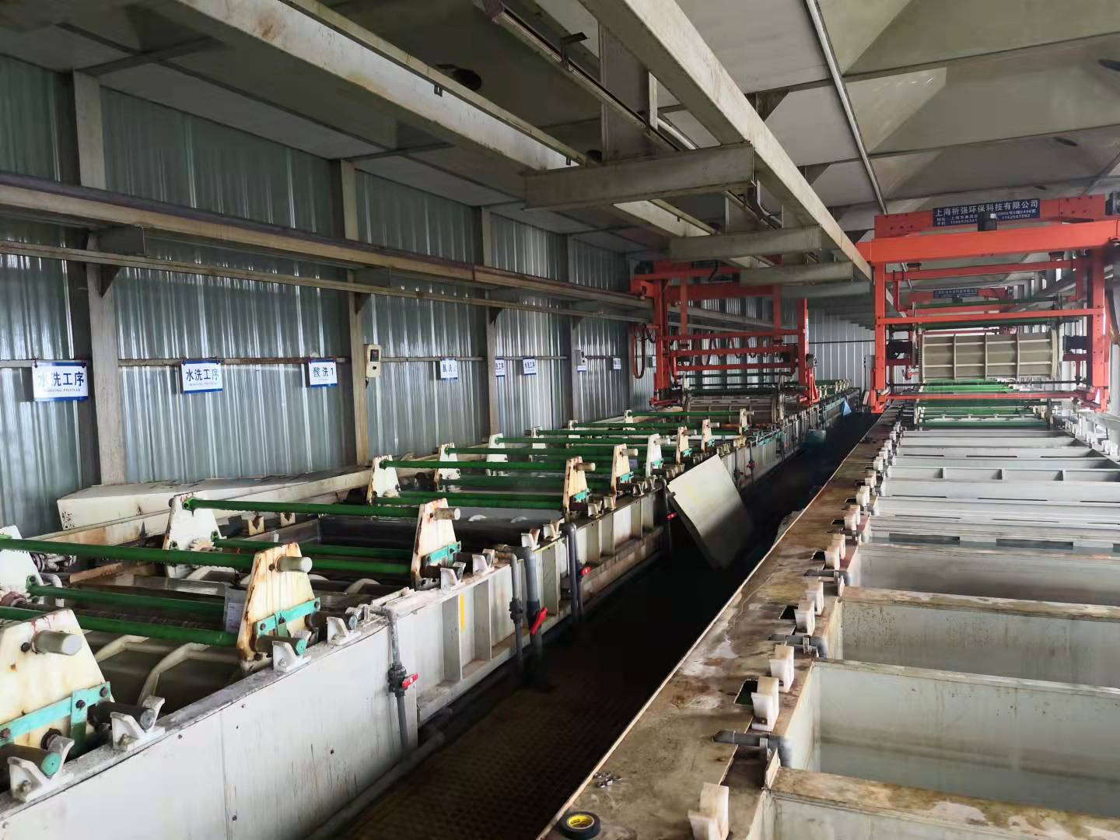
Part 1
Xuanhui Surface treatment Co.,ltd
Xuanhui plating is located in the Jianshe road 31, Jinheng plating industry 26 building 401, We are mainly engaged in galvanized, galvanized, black, phosphating, hard chrome plating, chemical nickel, tin plating, zinc nickel alloy and other surface treatment. Variety is complete, the price is reasonable, the enterprise strength is strong,we are a comprehensive enterprise.
The company introduced high-end equipment and technology, independently developed a set of plating solution management system, regular testing, analysis, maintenance, the plating product thickness is uniform, stable quality, product crystallization is meticulous, professional steel parts, all kinds of molds and other products plating hard chromium layer, good brightness, wear resistance, good binding force.

Slide 19
Part 1
CUSTOMER
外向型
Extrovert Type
Foreign trade is the main, international trade auxiliary.
16.4%
The sales ratio in 2019
Last year's sales volume was about 150 million,of which foreign trade accounted for 80% and domestic trade only accounted for 20%.
国内客户
83.6%
The sales ratio in 2020
Last year's sales volume was about 180 million,of which foreign trade accounted for 83.6% and domestic trade only accounted for 16.4%.
国外客户

Slide 20
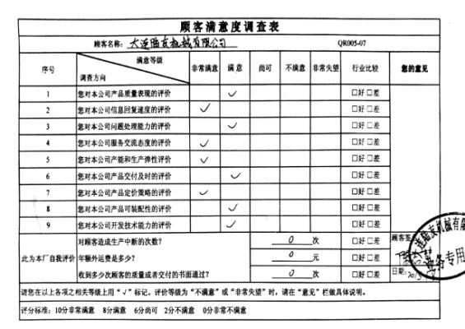
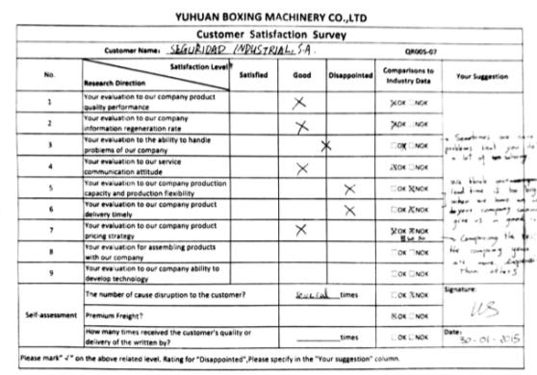
Part 1
客户满意度
Client Relations
We regularly and irregularly to their service customers satisfaction survey, in order to better improve the work, so that the business work progresses day by day.

Slide 21
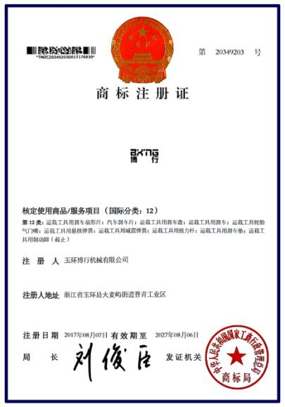
Part 1
Brand founded
Trademark registration
Since September 12, 2014, we have applied for the registration of "BBI" trademark for the first time, which was later rejected.
We always believes in the brand strategy. On June 17, 2016, we set sail again and applied for the registration of four trademarks, "BXNG+ BOXING", "RECHECK", "BXZD" and "BXBP", which have been successfully registered at present, It's paving the way for the company's subsequent brand construction.

Slide 22
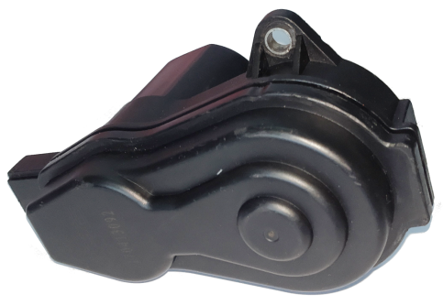
Part 1
Intellectual property rights
Our Company’s patent status
In order to coordinate with the transformation and upgrading of the company, as well as to protect and avoid intellectual property risk, we have applied for more than 10 technical product patents, and is applying for 3 invention patents and 5 utility patents, which included brake shoe, brake caliper and parking brakes.

Slide 23
Anhui Boxing Machinery CO.,LTD
02
CHAPTER TWO
System operation

Slide 24
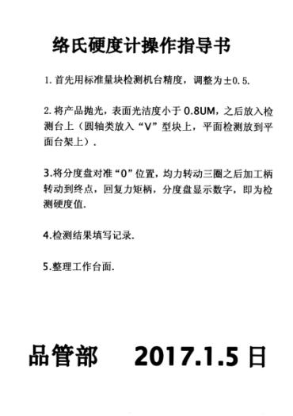
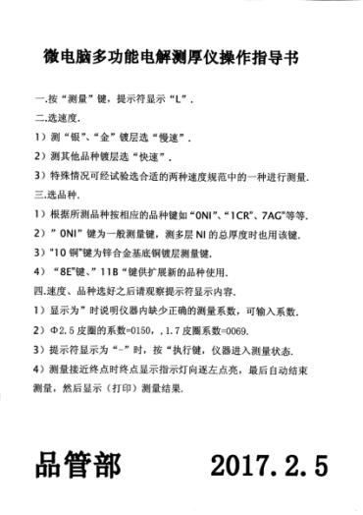
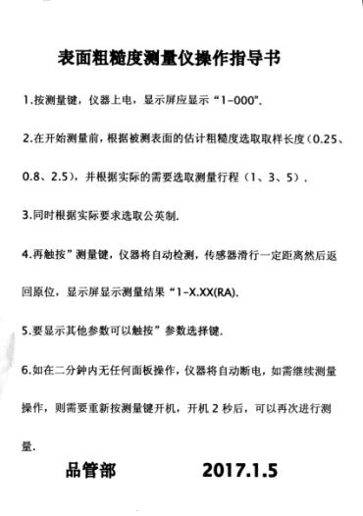
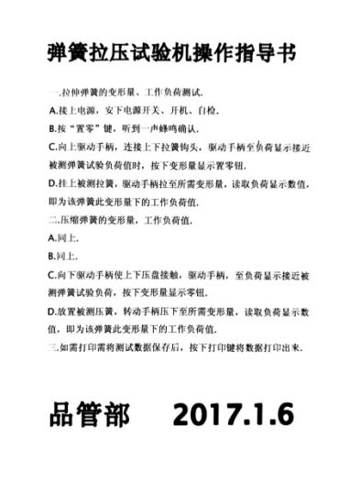
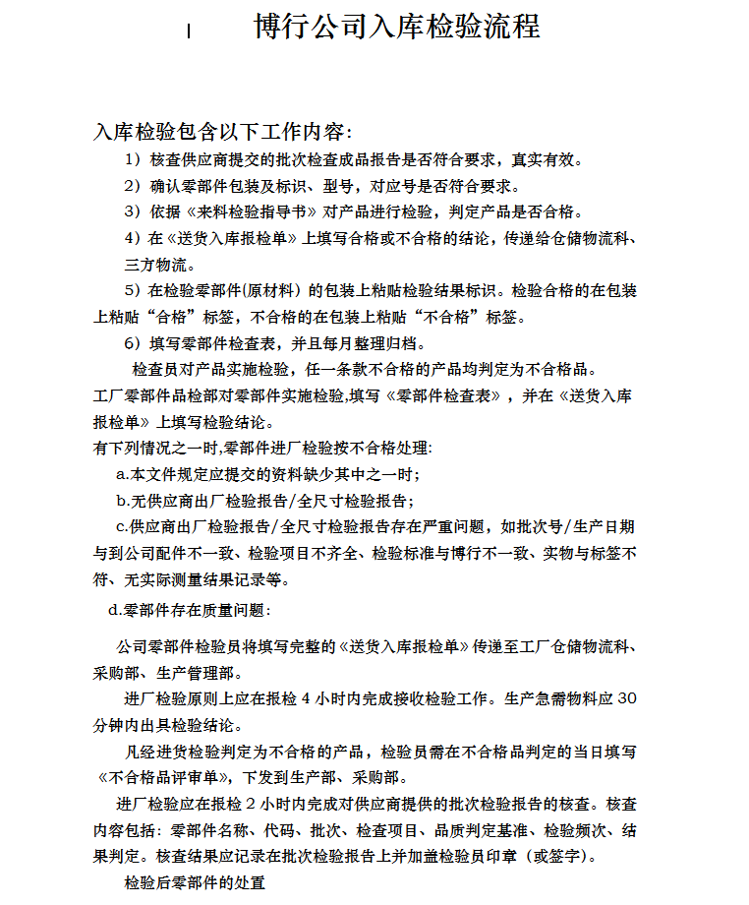
Part 2
Quality standard
STANDARD
In order to standardize the quality management, we formulate the operation procedures combined with the production characteristics and the actual situation.

Slide 25
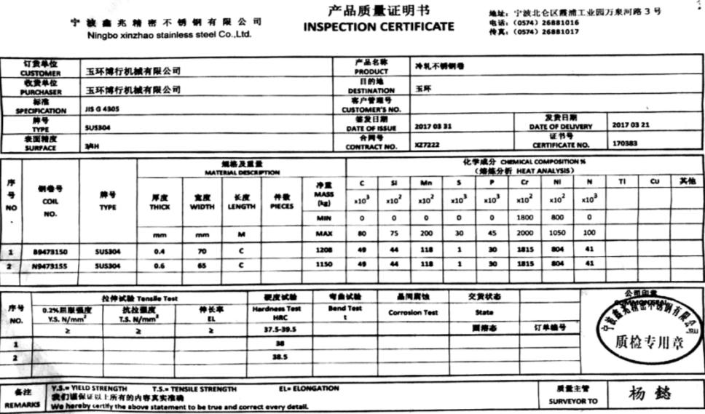
Part 2
Raw Material Certificate
1、Raw Material Certificate Report
Example

Slide 26
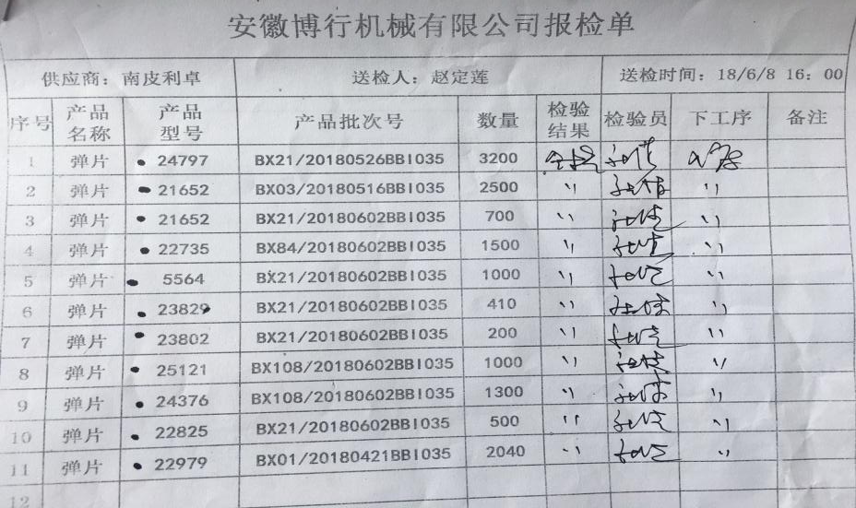
Part 2
Incoming inspection
2、Notice to be inspected
Example

Slide 27
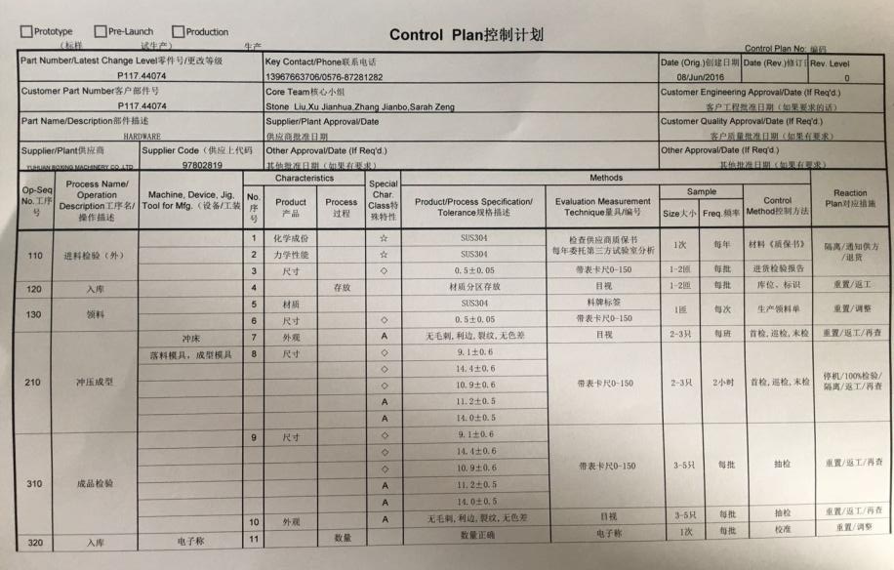
Part 2
Control Plan
3、Control Plan
Example

Slide 28
Part 2
Process analysis
4、Serious Process analysis
1
First inspection, inspection, final inspection
2
Non-conforming product report, review and disposal
3
Product testing
4
Non - product analysis and solution

Slide 29
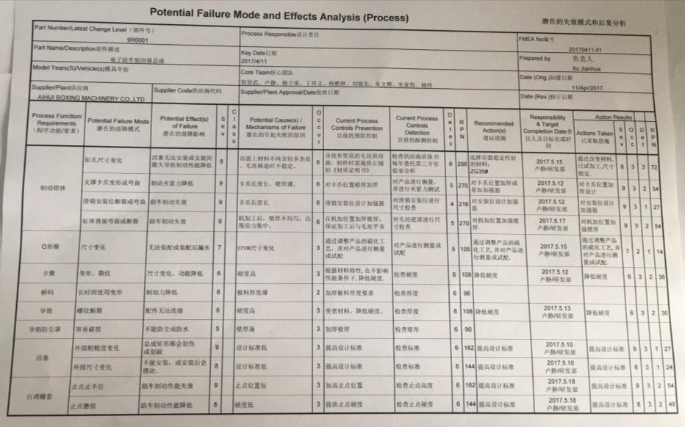
Part 2
FEMA
4、FEMA
样本

Slide 30
Anhui Boxing Machinery CO.,LTD
03
CHAPTER THREE
Supply chain management

Slide 31
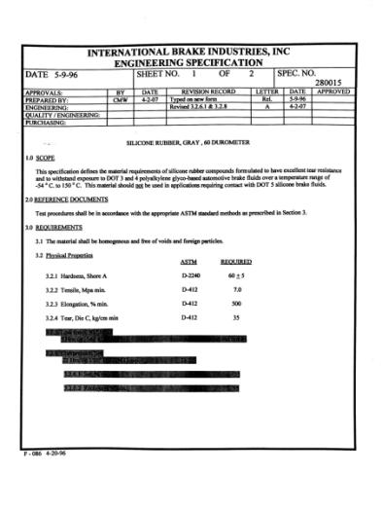
Part 3
Customer requirement
方法论
Methodology
Customer standard is our most important standard

Slide 32
Part 3
Supplier Management
Evaluation | Supplier A | Supplier B | Supplier C
Price
Supply in time
Quality
Production capacity
Company scale
certificate
others
As the extension of productive forces of our company , we always to strict choice better and better outsourcing resources as own duty
External Resources

Slide 33
Part 3
Supplier survey
Client Relations
In order to deal with different situations of customers, we inspect the our suppliers regularly and irregularly every year,

Slide 34
Anhui Boxing Machinery CO.,LTD
04
CHAPTER FOUR
Strategic planning, investment direction

Slide 35
Part 4
投资方向
2020.7
Heat treatment workshop completion and commissioning
Xuanhui surface teartment completion and commissioning
2020.6
Suzhou Tuoluzhe Management Consulting Co. LTD Wending Consulting Co. LTD
2020.6.2
Development and mass production of Garden tool
2021.3
Establish and prepare plant planning of Anhui Guoxing
2020.8.
Improve production capacity of
CNC Center
2021.4
Enterprise starts ERP\MAS system survey
Automatic production of equipment
安徽国行
2020.10
Chenxiang APP Running
2021.6
Piston Clod Forging workshop project approval, trial production
The blade pressure quenching workshop was established, and the blade of garden tool mower was put into production
2021.1
Mass production in Caliper automatic assembly line
2021.7
Anhui Guoxing Auto Parts Co., LTD
Plant construction
2021.6
Cold chain hardware series put into production

Slide 36
Part 4
Anhui Guoxing Auto Parts Co., LTD---aerial view
11%
85%

Slide 37
Part 4
Anhui Guoxing Auto Parts Co., LTD---Introduction
Our company is located at National Economic and Technological Development Zone, Xuancheng City, Anhui Province. The factory covers an area of 60 acres, about 40,048 square meters; the actual construction area is: 32,000 square meters; the storage center construction land is 10,000 square meters; the construction land of the comprehensive office building area is 2,000 square meters. Our total investment is about 400 million CNY, the equipment investment is about 100 million CNY, the supporting power supply facilities are 20 million CNY, and the circulating capital: 120 million CNY. The current construction investment of this project is 50 million CNY. In November 2021, the 1# workshop has been completed and put into operation; 2# workshop and 3# workshop are planned to be completed and put into full production around December 2022.

Slide 38
Part 4
Gardening tools
Gardening tools ---- blade
Initiated project and development in May,2020
Successful test in Oct,2020
Mass production officially began in Feb,2021
Apply for the patent of "one-time forming edge" product in April,2021
Sign long-term strategic relationship with customers in June,20201
Our goal: To become the industry's leading enterprise!
The annual output target :50million pcs
Domestic market
11%
Overseas market
85%

Slide 39
Part 4
Phenolic piston
The characteristics of the phenolic piston
Project schedule
1、High temperature and corrosion resistance;
2、Quality of portable, easy to store ；
3、Chemically inactive, unfavorable decomposition
By the end of March 2020, we have the products nearly 120 kinds of pistons and we collect enough experience ,in the next stage , we will focus on introduce and expend our phenolic piston business to our customer.

Slide 40
Anhui Boxing Machinery CO.,LTD
05
CHAPTER FIVE
The company environment

Slide 41
Part 5
Laboratory - Testing equipment
The projector
Torsion test machine
Hardness test machine

Slide 42
Part 5
Laboratory – Main testing equipment-CMM

Slide 43
Part 5
Team

Slide 44
Part 5
Team

Slide 45
Part 5
Team

Slide 46
TM
博者行天下
Do great things , for great love.
制动器卡钳|卡钳配件|附件包|弹片|橡胶件
欢迎关注安徽博行机械有限公司

Slide 47
Anhui Boxing Machinery CO.,LTD
TM
博 者 行 天 下
Do great things , for great love.

